Slide 1
GRADE SIX SCIENCE PROPERTIES OF SOIL TEACHER EDWIN JUMA
ON 20TH JUNE 2025

Slide 2
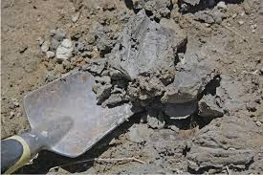
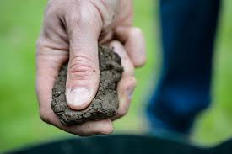
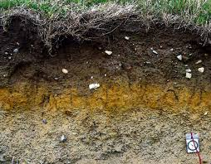
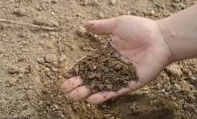
IMAGES ON TYPES OF SOILS
CLAY SOIL
ITS STICKY, HEAVY AND HOLDS WATER WELL

Slide 3
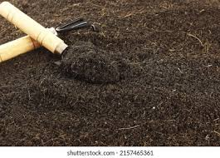
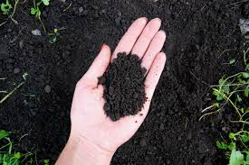
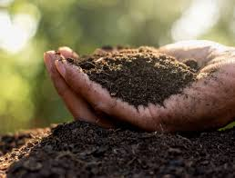
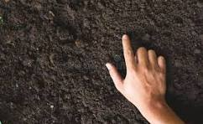
LOAMY SOIL
BEST FOR FARMING, RICH AND DARK, IT’S WELL-BALANCIED. IT’S A MIXTURE OF SAND, CLAY AND SILT

Slide 4
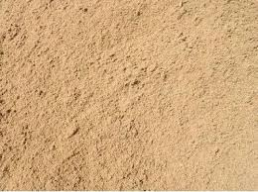
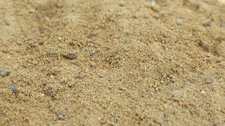
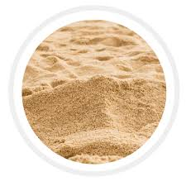
SAND SOIL
IT’S LIGHT, GRITTY AND DRAINS WATER QUICKLY

Slide 5
SOIL CHARACTERISTICS AND IMPORTANCE
Sandy soil: Good for drainage but has low nutrients.
Clay soil: Rich in nutrients but poor drainage.
Loamy: Ideal for farming because it has air, nutrients and water. It supports plant growth, filters water, provides habitats.

